Slide 1
Cybersecurity
Cryptographic Attacks

Slide 2

Cryptographic Attacks
Strong encryption helps ensure safe communication between sender and receiver
Modern encryption methods are based on algorithms that are relatively easy to compute but difficult and time consuming to decrypt without the key
It’s been said encryption has existed in some form for as long as there have been written secrets
Attempts to break encryption by a third party must be anticipated
The following attacks are popular methods to cracking

Slide 3

Collisions
Hashes are very useful in ensure data integrity
Hash values are supposed to be unique
Different input values should never create the same output result
When hashes are the same, this is called a collision
The MD5 hashing algorithm is a popular method
Collisions in MD5 can be generated.
MD5 first published in 1992
MD5 Collisions identified in 1996
MD5 is useful but not safe. New hashing methods used now

Slide 4
Collision example
Following two large values generate the same MD5 hash
Collisions are bad for secure, trust-worthy encryption!
Solution is often to make resulting hash values larger
d131dd02c5e6eec4693d9a0698aff95c 2fcab58712467eab4004583eb8fb7f89 55ad340609f4b30283e488832571415a 085125e8f7cdc99fd91dbdf280373c5b d8823e3156348f5bae6dacd436c919c6 dd53e2b487da03fd02396306d248cda0 e99f33420f577ee8ce54b67080a80d1e c69821bcb6a8839396f9652b6ff72a70 | d131dd02c5e6eec4693d9a0698aff95c 2fcab50712467eab4004583eb8fb7f89 55ad340609f4b30283e4888325f1415a 085125e8f7cdc99fd91dbd7280373c5b d8823e3156348f5bae6dacd436c919c6 dd53e23487da03fd02396306d248cda0 e99f33420f577ee8ce54b67080280d1e c69821bcb6a8839396f965ab6ff72a70
MD5 Hash: 79054025255fb1a26e4bc422aef54eb4 | MD5 Hash: 79054025255fb1a26e4bc422aef54eb4

Slide 5

Birthday Problem
With a group of 30 people, what are the chances that any two individuals share a birthday?
Remember, there are 365 possible birthdays (+1 if you count Leap Day)
Actually works out to ~70%!
Seems crazy, known as the Birthday Problem or Birthday Paradox. Chances go up as more people are added to the group.
This statistical anomaly is basis for The Birthday Attack

Slide 6
Birthday Attack
Instead of matching birthdays, let’s look for matching hash values. (In the cyber world, this is a hash collision)
Find a collision through brute force
Might seem like it’ll take a super long time, but Birthday Paradox suggests it might not take as long
Hacker generates multiple versions of plaintext to hash then check for matching hashes
Protect yourself with a large hash output size (e.g. MD5 hashes are only 32 characters long)

Slide 7
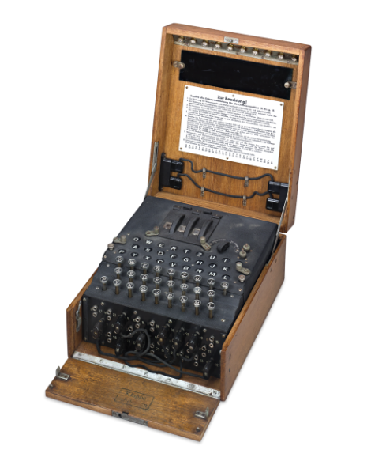

Known-plaintext Attack (KPA)
Model for cryptanalysis
Hacker has plaintext (“crib”) and encrypted form
Used by British in WW2 to crack Nazi Enigma machine
British codebreakers at Bletchley Park had both encrypted messages and some key phrases – “Heil Hitler” at end of every message.
Encryption easier to crack if you know some plaintext
British RAF would drop naval mines in North Sea to “seed” enemy encrypted radio traffic
Messages would reference the place, so Brits could look for that “crib” in encrypted form. Other letters would fall into place once they had location decoded from the message.

Slide 8
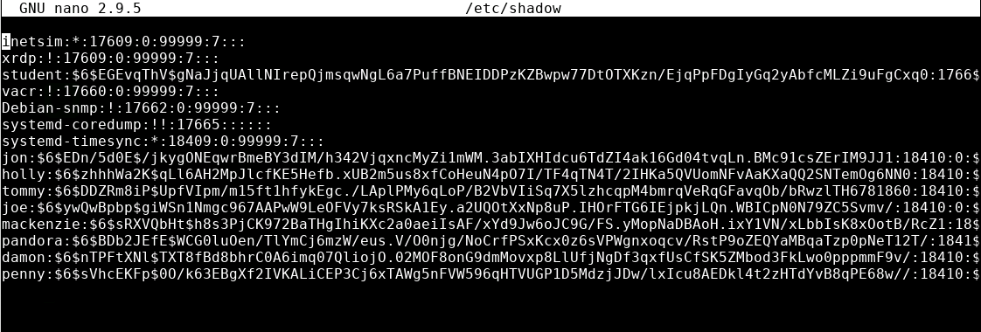
The Password File
Each OS stores passwords differently
Example: Linux /etc/shadow file

Slide 9

Rainbow Tables
Pre-calculated series of hashes using known hashing algorithms
Commonly used for cracking passwords
Find the matching hash
Look up the input text that gave the result
Voila! There’s the password/input string
Rainbow table built for each application
No one table for all uses
Defense: Salt your passwords
Rainbow tables would be unwieldy if inputs had to be checked with different salt values

Slide 10

Brute Force
Brute force = try all possible combinations and permutations until the right guess works
Like trying to guess a number by sequentially trying every number starting at 0… 1… 2…
Very slow
Many systems will lock you out after X failed attempts
Doing this offline will not lock you out
Requires password file with usernames and hashes

Slide 11

Dictionary Attacks
Most passwords are comprised of common words
If using brute force attack, try dictionary attack first. Be sure it isn’t easy-to-guess like single word from dictionary
Wordlists are available online
Made up of cracked/leaked password files from old cyberattacks
Each year, articles pop up of “Most common passwords of 20__.”
Only good against simplistic passwords
Every organization has someone that uses a weak password!
Defense: In past, common practice was letter replacement: tH15 15 4n 3x4mpl3 p4SsW0rD [not that secure!]
Defense: Enforce strong password criteria

Slide 12
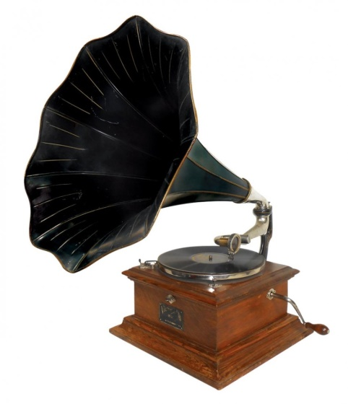
Downgrade Attack
Old cryptographic processes are abandoned for newer, more secure algorithms
Due to compatibility issues, some older code or systems may use less-than-ideal cryptography
Forcing one system to downgrade its security weakens the security of the entire system
Old crypto algorithms are retired for a reason!
Don’t use weak crypto!

Slide 13
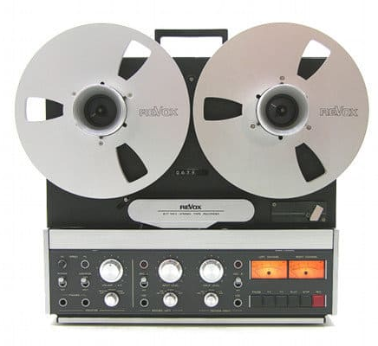
Replay Attacks
Some cryptographic algorithms fall prey to replay attacks
Ones that do not use session IDs
Ones that do not use timestamps
Hacker captures authentication communications
Replays authentication process on their own and is granted access
Replay countermeasures may be built into crypto system
Kerberos and similar systems use time stamps
Anything expired requests are ignored

Slide 14

Weak Implementations
Weakest link breaks the chain
Security is only as strong as the weakest link
Don’t rely on weak encryption or anything else you do will be for nothing
802.11 WEP
RC4 key can be cracked by grabbing packets
Can be cracked in minutes
DES – Data Encryption Standard
Uses short 56-bit keys
Now with Rainbow Tables, DES can be cracked in seconds!

